Slide 1
TEAL Documentation using Google Drive

Slide 2
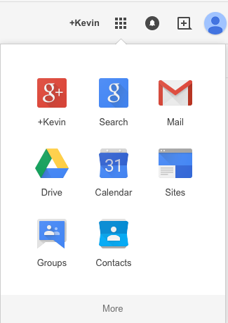
Open www.port.ac.uk/students on a browser
Select Google mail > login
Click
Select

Slide 3
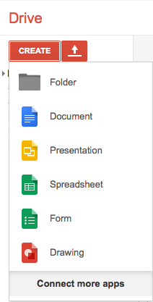
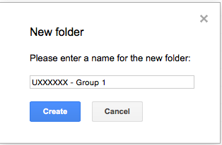
Click on “No thanks” is shown on.
Click on a Folder
Label the Folder as shown below

Slide 4
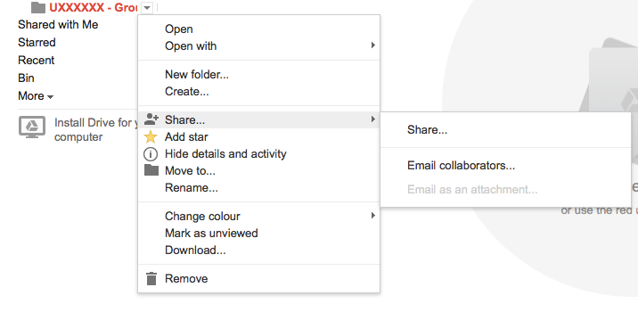
Right-click on the Folder
Click on “Email collaborators”
Using the diagram
Share > Email Collaborator

Slide 5
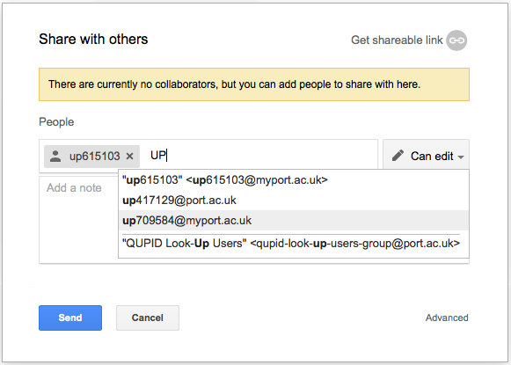
Add email addresses of the students in your group
and your lecturer’s email.
Then click send

Slide 6
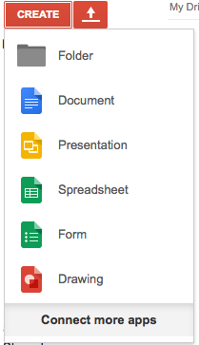
Then open and share a documents
with your group
Document > Microsoft Word
Presentation > Microsoft Powerpoint
Spreadsheet > Excel

